Slide 1

Synthetic Data Generation Using LLM
Sakil Ansari

Slide 2
Agenda
What
How
Tools
Why
Use Cases
Bonus

Slide 3
What is Synthetic Data?
Artificially generated data.
Created using different algorithms
Generated to mimic real data
Tailored Environment for Enhancing AI and ML Algorithms

Slide 4
Why is Synthetic Data required
Artificially generated data.
Created using different algorithms
Generated to mimic real data
Tailored Environment for Enhancing AI and ML Algorithms
Three Main Reasons
Privacy concerns
Faster turnaround for product testing
Training machine learning algorithms

Slide 5
Benefits of Synthetic Data
Artificially generated data.
Created using different algorithms
Generated to mimic real data
Tailored Environment for Enhancing AI and ML Algorithms
Three Main Reasons
Privacy concerns
Faster turnaround for product testing
Training machine learning algorithms
Benefits of Synthetic Data
Privacy and Security: No real personal data at risk of breaches.
Data Augmentation: Expands datasets for machine learning.
Flexibility: Create specific or rare scenarios.
Cost-effective: Often cheaper than real-world data collection.
Regulatory Compliance: Helps navigate strict data protection laws.
Model Robustness: Can lead to better generalizing AI models.
Rapid Prototyping: Enables quick testing without real data.
Controlled Experimentation: Simulate specific conditions.
Access to Data: Alternative when real data isn’t available.

Slide 6
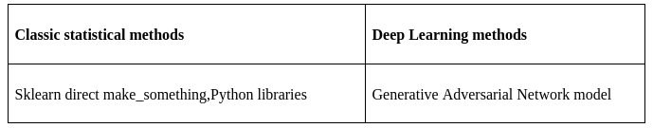
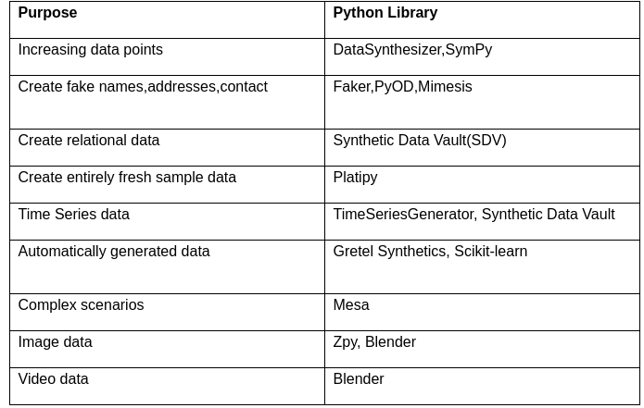
Synthetic data generation methods
List of Python based Libraries

Slide 7

Synthetic Data Generation Process Using LLM

Slide 8

Synthetic Data Generation Process Using LLM

Slide 9

Synthetic Data Generation Process Using LLM

Slide 10

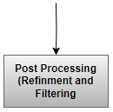
Synthetic Data Generation Process Using LLM

Slide 11
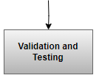
Synthetic Data Generation Process Using LLM

Slide 12
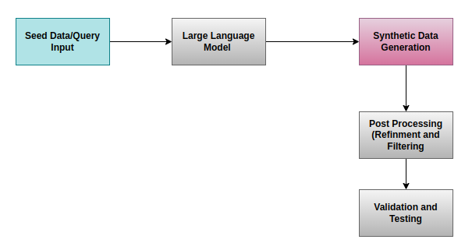
Synthetic Data Generation Process Using LLM

Slide 13
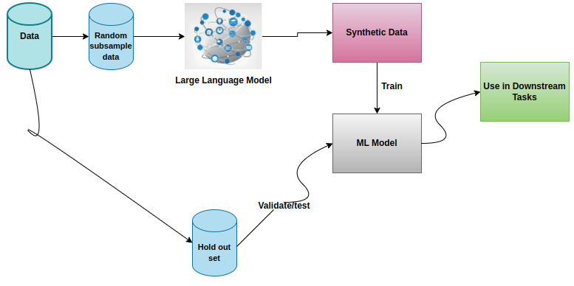
Train Synthetic,Test Real(TSTR)

Slide 14
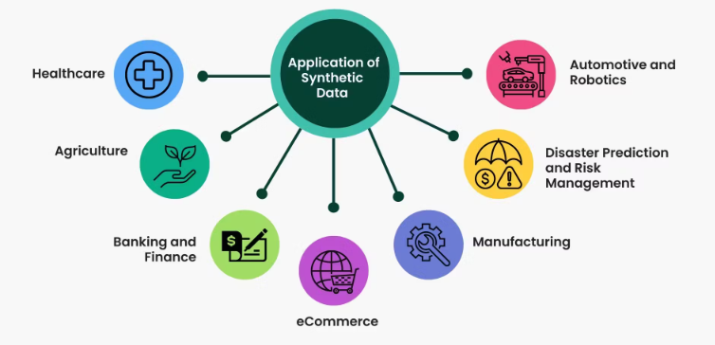
Use Cases/Applications

Slide 15
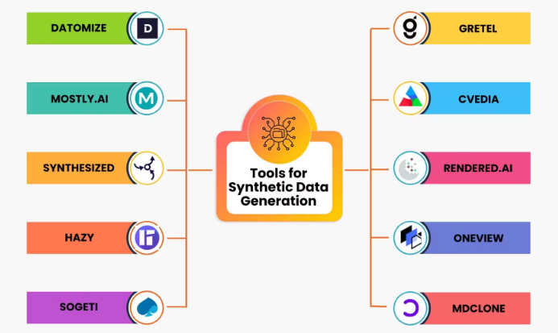
Synthetic Data Generation Tools

Slide 16
BONUS

Slide 17







Low Code No Code
Low Code No Code Platforms | Link
 | https://vextapp.com/
 | https://lmstudio.ai/
 | https://julius.ai/
 | https://www.langflow.org/
 | https://dify.ai/
 | https://microsoft.github.io/promptflow/
 | https://github.com/FlowiseAI/Flowise

Slide 18

Thank You

